Slide 1
WiT Hackathon :
Aarogya@Home Roadmap

Slide 2
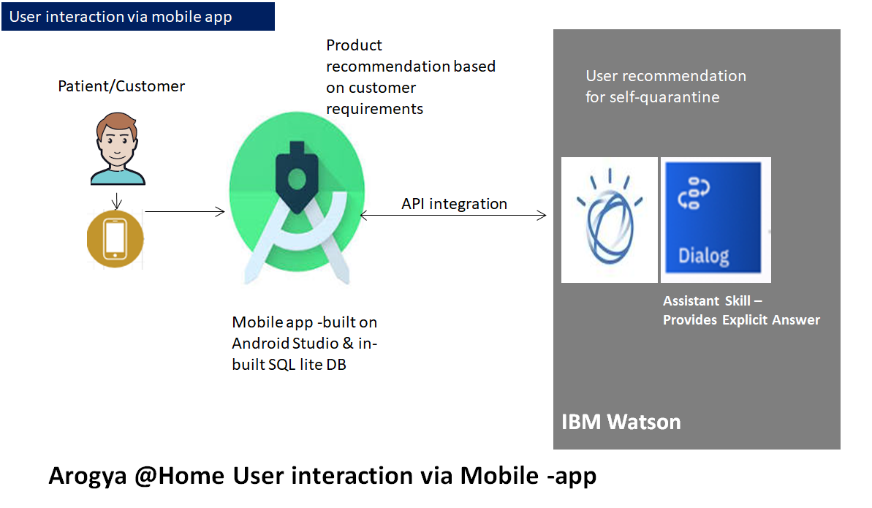

Slide 3
Roadmap Architecture –
Aarogya@Home

Slide 4












Vendor Portal and CRM view
AWS Cloud
Vendor login
S3 Static Website Hosting
Cognito Authentication
CloudFront
S3 Bucket
Vendor Data Pull and push
Dynamo dB Stores vendor offering detail
Arogya@Home Vendor Portal
API – via API Gateway
Lambda

Slide 5






E2E Architecture integrating Vendor portal and the mobile app.
AWS Cloud
3rd party payment gtways
IBM Watson
Vendor login
S3 Static Website Hosting
Android User
Cognito Authentication
API integration
CloudFront
S3 Bucket
Cognito Authentication
Mobile app -built on Android Studio
Assistant Skill –
Provides Explicit Answer
Vendor Data Pull and push
User recommendation for self-quarantine and view of different offerings available at Arogya@Home
Dynamo dB or RDS Stores vendor offering detail
Arogya@Home Vendor Portal
API – via API Gateway
Lambda
Arogya @Home User interaction via Mobile -app

Slide 6
Roadmap
We plan to build the partner eCo system using AWS cloud services. Central database will be DynamoDB in AWS, which would interact with Vendor portals and Customer’s mobile app via AWS APIGWs.
Customer and Vendor’s login and access will be managed by AWS Cognito authentication service.
Payment capability in the Mobile App will be built by integrating 3rd party payment services.
Customer experience in mobile app will continue to be supported by IBM Watson service and API
Platform ready for integration
IAM functionality ready
Platform development
Database on Cloud
Business logic on cloud
AWS API Gateway
Identity and Access Management
AWS DynamoDB and Data model
AWS Lambda
API Layer
Aamazon Cognito and IAM services
Vendor portal development
AWS JS/S3/Cloudfront
Database integration
Cognito and IAM
Identity and access management
Vendor portal development
APIGW
Mobile App integration with the platform
AWS APIGW
Android App integration
Cognito and IAM integration
Identity and access management
3rd party payment vendors APIs
3rd party payment services integration

